Slide 1
The Project Management Body of Knowledge
Presented By
Bidhya Baram

Slide 2
Contents
Introduction
Project management processes
Project management knowledge area

Slide 3
Introduction
The Project Management Body of Knowledge (PMBOK) is a set of guidelines and standards for project management.
It was developed by the Project Management Institute (PMI) and is considered the gold standard in the field of project management.
The PMBOK provides a common language and a standardized approach to project management.
It is used as a reference by practitioners and organizations around the world.

Slide 4
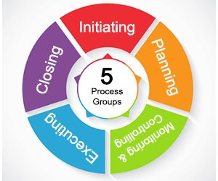
Process
Initiating processes: These processes involve defining the project and obtaining authorization to begin work.
Planning processes: These processes involve defining and refining the project objectives and creating a detailed plan for achieving them.
Executing processes: These processes involve carrying out the project according to the plan.
Monitoring and controlling processes: These processes involve tracking progress and making adjustments as needed to ensure that the project stays on track.
Closing processes: These processes involve completing all activities across all process groups to formally close the project.

Slide 5
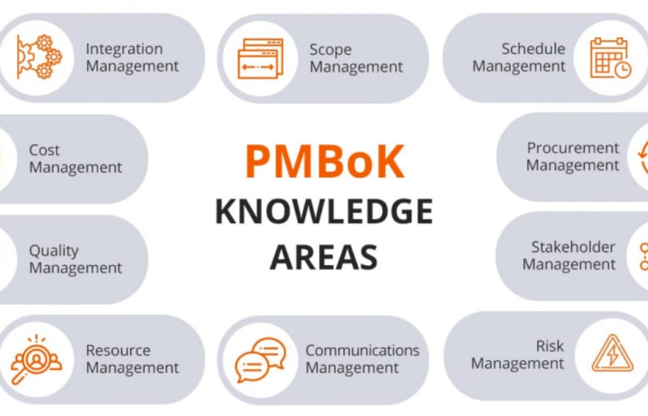
Knowledge Area
Integration Management
Scope Management
Schedule Management
Cost Management
Quality Management
Resource Management
Communications Management
Risk Management
Procurement Management
Stakeholder Management.

Slide 6
Integration Management
It describes the processes required to ensure that the various elements of the project are properly coordinated.
It includes the process and activities to identify, define, combine, unify and coordinate the various processes of project management activities within the project management process group.
There are 6 processes of project integration management including Develop project charter, Develop Project management plan, Direct and manage project work, Monitor and control project work, perform integrated change control and close project or phase.

Slide 7
Scope Management
It describes the processes involved in defining and controlling what is or is not included in the project.
To ensure that the project includes all the required work and only the required work (No More-No Less) in order to complete project successfully.
Project scope management contains 6 processes including Plan scope management, collect requirements, define scope, create work breakdown structure, validate scope and control scope.

Slide 8
Schedule Management
It describes the processes required to ensure timely completion of project.
It is considered to be a core knowledge area, and is closely bind with cost and scope of project.
The main purpose of this knowledge area, as it name suggests, is to build processes and outputs into the project that assist the manager and team to complete the project in a timely manner.
There are 7 processes of Project time management including plan schedule management, define activities, sequence activities, estimate activity resources, estimate activity duration, develop schedule and control schedule.

Slide 9
Cost Management
It describes the processes required to ensure that the project is completed within the approved budget.
Project managers must understand basic principles of cost management to be effective in managing project cost.
There are 4 processes in this knowledge area including plan cost management, estimate cost, determine budget and control cost.

Slide 10
Quality Management
It describes the processes required to ensure that the project will satisfy the needs for which it was undertaken.
It includes the activities that determine quality polices, objectives, quality systems and responsibilities to satisfy the needs of end user and customer expectations relating to project deliverable.
Project quality management ensures that the project expectations, including project requirements are fully met and validated.
It contains 3 processes including plan quality management, perform quality assurance and control quality.

Slide 11
Resource Management
It describes the processes required to make the most use of people involved with the project.
It includes the process of identifying project roles, responsibilities, making job descriptions, reporting relationships, staff management plan, confirming HR availability and obtaining them, improving competence, job environment, tracking performance and proving feedback.
These all are isolated into 4 processes of project human resource management including plan human resource management, acquire human resource, develop human resource and manage human resource.

Slide 12
Communication Management
It describes the processes required to ensure timely and appropriate generation, collection, storage, distribution and ultimate disposition of project information.
Communication plays a major role in success of any project and it requires strong verbal skills.
Project manager must be able to communicate effectively because it’s a greatest threat to the failure of many projects.
Project communication management comprises of 3 processes including plan communication management, manage communication and control communication.

Slide 13
Risk Management
It describes the processes concerned with identifying, analyzing and responding to project risks throughout the life of project to meet project objectives.
Risk management is all about minimizing the chances of failure.
It is a continuous process of identifying and managing uncertain events that can be negative or positive.
On the bases of nature and occurrence, risk can be known-unknown and unknown-unknown, and on the bases of sources of occurrence, risk can be internal and external to the project.
There are 6 processes of project risk management including plan risk management, identify risk, perform qualitative risk analysis, perform quantitative risk analysis, plan risk responses and control risks.

Slide 14
Procure Management
It describes the processes required for acquiring or purchasing the goods, services, material and equipment from outside the performing organization to perform the project work.
It also includes contract management and change control system to manage changing in contracts.
This knowledge area is carefully integrated with project schedule as failing which delay can occur on project.
4 processes that covered under project procurement management are plan procurement management, conduct procurement, control procurement and close procurement.

Slide 15
Stakeholders Management
It describes the processes involved in managing the expectations of those who have some interest in project and that could affect or be affected by project deliverable.
Stakeholder management is a process and control that must be planned and guided by primary principles, as it is a critical component to the successful delivery of any project.
It is included as a 10th knowledge area in 5th edition of PMBOK.
There are 4 processes of project stakeholder management that includes identify stakeholders, plan stakeholder management, manage stakeholder engagement and control stakeholder engagement.

Slide 16


Thank You for your patience.

